Slide 1


Value-Driven Model for Healthcare
Where Value is Measured in the eyes of the patient

Slide 2
Proposal
Define a new approach for measuring the value of healthcare (using a patient-driven model)
To provide a unified vision for delivering sustainable value for patients, practitioners, and provider.
To drive innovation & collaboration.
To guide continuous improvement (quality and efficiency) across the continuum of care

Slide 3



The Vision
Value
Quality
Practitioner-Driven
Results
Provider-Driven
Patient-Driven
“Health care organizations are increasingly concerned with looking beyond financial performance measures, while focusing on how to deliver higher quality care “
- Love, Dianne, Revere, Lee, and Black, Ken. (2008), Journal of Health Care Finance

Slide 4
Needs of the Patients
To have affordable healthcare.
To have attainable healthcare.
To have more accessible healthcare.
To have consistent levels of quality (results).
To receive a total healthcare experience:
Ensure their functional outcomes met.
Ensure their emotional outcomes met.
Ensure their outcomes are met across the continuum of care (beyond the hospital, into clinics, and into the home).
“We continue to pay for lots of medical procedures that don't add to health value and in fact just add costs to the system..”
- Kathleen Sebelius

Slide 5
Needs of the Practitioners
To improve diagnostic capabilities in a cost-effective manner.
To improve clinical processes.
To provide consistent levels of quality.
To move beyond service, where they can deliver a positive experience.
To be able to reliably measure value for their patients, for themselves as individual practitioners , and for their practices.

Slide 6
Needs of the Providers
To get pharmaceutical and device manufacturers, insurers, and healthcare suppliers to become aligned, unified and collaboratively focused on a consistent set of outcomes.
To increase collaboration NOT competition.
To understand how to identify, measure and deliver value throughout the healthcare value network.
To move towards a shared revenue model where everyone can still win, but not at the expense of others (esp. the patients & the public).

Slide 7
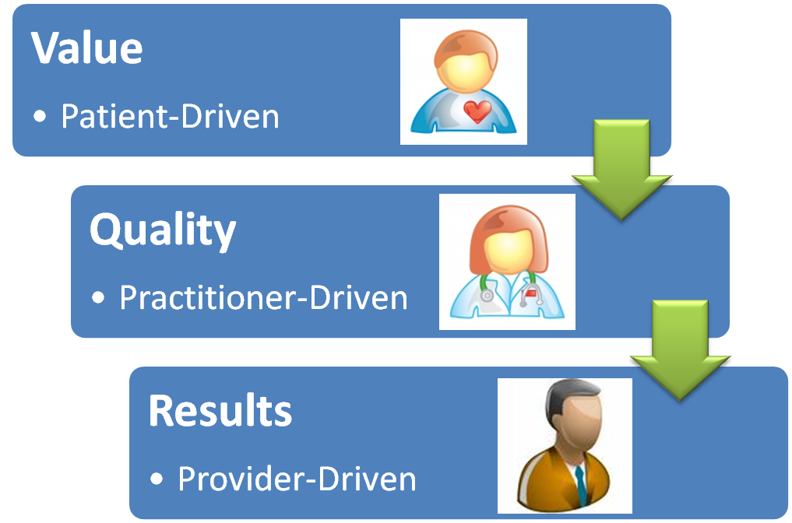
An Expanded Membership Model
Providing Patients with a way to measure the value they should be receiving for healthcare throughout the continuum
Guiding Practitioners to measure and optimize the value they deliver to Patients
Guiding the Providers to deliver value to Patients & Practitioners

Slide 8
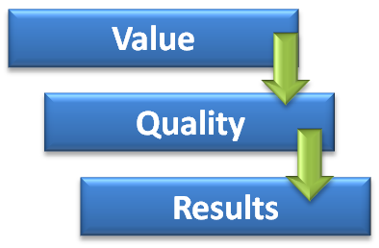
Moving from Assumptions to Implementation
Establish a program focused on mapping the Jobs & Outcomes across the healthcare domain.
Build a portfolio of unmet needs (opportunities) for improving value delivery to patients and practitioners.
Establish a prioritization model to direct resources in an efficient manner.
Create an open innovation framework using the opportunities to generate ideas that can address the most important (prioritized) unmet needs.
Establish a shared revenue model as part of a collaborative to address unmet needs.

Slide 9
Measuring Value for Healthcare
Build a portfolio of jobs & outcomes:
For measuring value *
For driving innovation
For directing efforts to improve quality
For guiding initiatives to reduce cost
* Value is created between the Patient & Practitioner

Slide 10
Enabling Value for Healthcare
Value-Driven Healthcare Platform
Technology
Ideas
Resources
Innovation
Value Measurement
New Concepts
New Products & Services
New Value Delivery
Outcomes
Compliance
Quality & Efficiency
Value-Driven metrics are used to drive innovation & direct Quality & Efficiency

Slide 11
Thank You
Prepared by
Jeffrey Wallk (Managing Partner)
P.K. Rastogi, Phd (Strategic Partner)

Slide 12
Management Consulting firm dedicated to helping clients identify & create sustainable value for their customers & stakeholders.

Slide 13
Our Services
Enabling Innovation
Institutionalize Customer Focus
Portfolio Mgmt for Customer Needs, Ideas, & opportunities
Drive efficiency into the ideation pipeline
Aligning Value Platforms with Technology Platforms
Enabling Adaptation & Agility
Model products & services for agility and adaptability
Drive reuse of assets thru holistic portfolio Mgmt
Leverage Quality to enable change
Optimize Platforms Change Mgmt Platform for sustainable value
Enabling Operational Excellence
Model-driven outcomes (beyond BPM)
Infuse Quality & continuous learning into all processes
Make technology transparent
Drive efficiency & productivity thru an outcome focus
Enabling Business Models
Profiling risk to create opportunity
Collaboration as a core competency
Leverage disruptive innovation
Fail Fast Forward to achieve growth
Embracing change
Modeling for sustainable value
Enabling Knowledge
Modeling data to enhance knowledge capture (explicit & tacit information)
Integrating information and insights to enable knowledge consumption
Designing platforms for sustainable learning

Slide 14
Our Expertise
Strategic
Operational
Technical
Driving Change
Strategic Planning
Business Model Innovation
Enterprise Architecture
Driving Innovation
Driving Innovation
Continuous Improvement
Driving Sustainability
Process Models
Metric Models
Integration Platforms
Knowledge Management
Driving Growth
Prioritization
Portfolio Planning
Resource Planning
Product Design - Testing
Execution Management
Driving Customer Value
Customer Focus
Market Assessment
Value Platforms
Investment Planning
Product Roadmaps
Portfolio Planning
Driving Agility & Scale
Technology Platforms
Technology Alignment
Technology Optimization
Service Level Management
Agile Delivery
Adaptable Design
Driving Quality
Six Sigma
Lean & Kaizen

